Slide 1
Persuading Municipal Officials to Go With TNR
Rethinking the Cat
Bryan Kortis
Program Manager, PetSmart Charities
bkortis@petsmartcharities.org

Slide 2
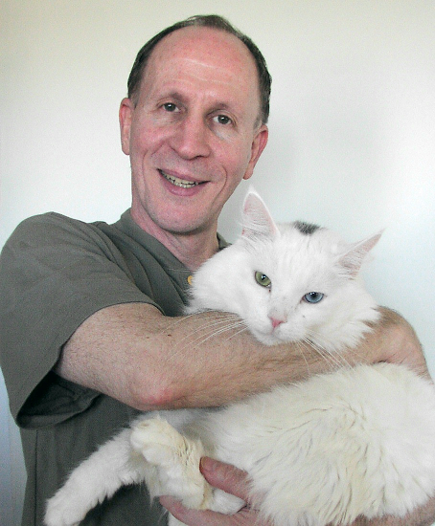
Your presenter
Bryan Kortis (with Pemberly)
Currently:
PetSmart Charities Program Manager
Attorney (NY State)
Previously:
Co-founder & Executive Director of Neighborhood Cats

Slide 3
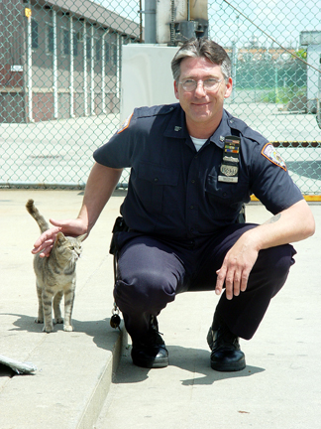
3 step structure of a pro-TNR presentation
Identify government’s interests in free-roaming cats – what are the problems that should concern them?
Discuss alternatives besides TNR for trying to solve these problems and why they don’t work
Introduce TNR, what it is, why it works and examples of success

Slide 4
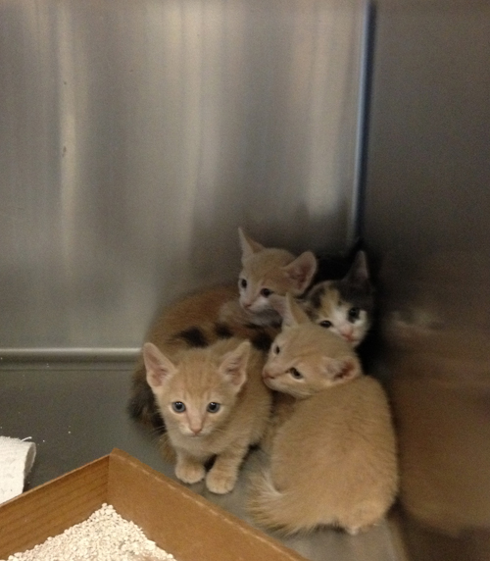
Municipal interests: shelters & animal control
Cat intake & euthanasia at open admission shelters
Complaint calls
Staff resources (trapping, shelter care) & other costs
Opportunity costs (foregone programs)
Public relations / adoptions

Slide 5
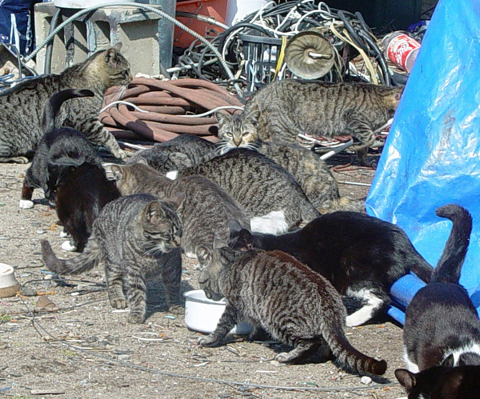
Municipal interests: public health
Rabies
Other zoonotic diseases & parasites
Quality of life complaints
- odor
- noise
- property damage
- unsanitary conditions
Investigation costs

Slide 6
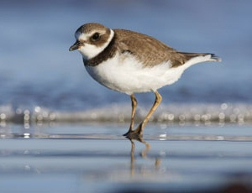
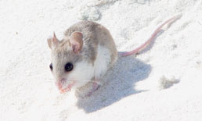
Municipal interests: wildlife
Predation
Competition
Potentially devastating impact on rare species vulnerable to cat attacks
Alabama beach mouse
Piping plover

Slide 7
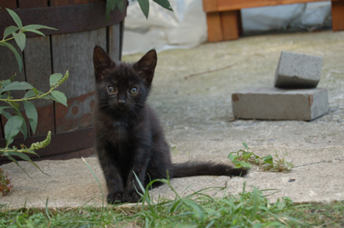
Municipal interests: animal welfare
High kitten mortality
Short life span for adults who are unmanaged (no TNR)
Environmental dangers (cars, cruelty, disease, fighting, climate)
This interest is the weakest from a government point of view!

Slide 8
Step 1 is important because…
By acknowledging the problems instead of trying to ignore or minimize them, you:
Establish credibility
Demonstrate free-roaming cat overpopulation is a serious issue that government should pay attention to
Allows you to move the discussion to the real issue for municipal officials - what is the best way to reduce the cats’ numbers & any negative impacts?

Slide 9
Step 2: Alternatives to TNR
Trap & remove (usually for euthanasia)
Feeding ban
Laws (e.g., licensing, at-large, pet limits)
Do nothing
Magic wand to make them all disappear

Slide 10
Step 2: Alternatives to TNR
Trap & remove (usually for euthanasia)
Feeding ban
Laws (e.g., licensing, at-large, pet limits)
Do nothing
Magic wand to make them all disappear

Slide 11
Step 2: Alternatives to TNR
Trap & remove (usually for euthanasia)
Feeding ban
Laws (e.g., licensing, at-large, pet limits)
Do nothing
Magic wand to make them all disappear
The point you’re making is: Nothing else works!

Slide 12
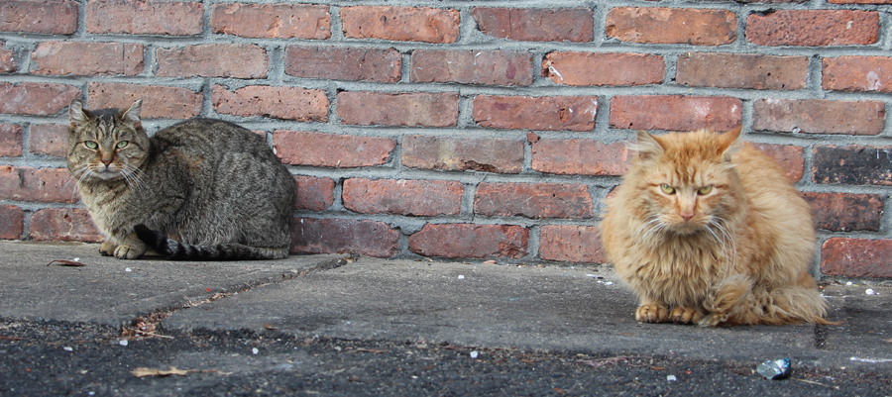
Doing nothing doesn’t work because:
You’re doing nothing!
Cats will remain at the carrying capacity of the environment (which can increase if more food & shelter is provided)
Does not address the government’s interests in animal control, public health, wildlife predation and animal welfare

Slide 13
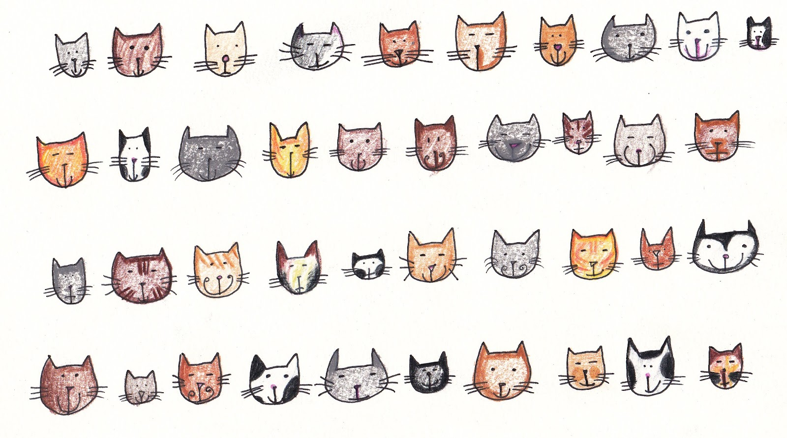

Trap & remove/euthanize doesn’t work because:
Too many cats, too few animal control officers
Caretaker resistance / lack of public support
Vacuum effect (new cats arrive to take advantage of vacated food & shelter)
Ongoing abandonment + lack of monitoring
Synergy of these factors

Slide 14
Quick responses
“Why don’t we just get rid of them all?”
“Who’s going to do it and who’s going to pay for it?”
“After decades of trying to remove them, this country/county/town has an exploding free-roaming cat population. Time to try something new?”

Slide 15
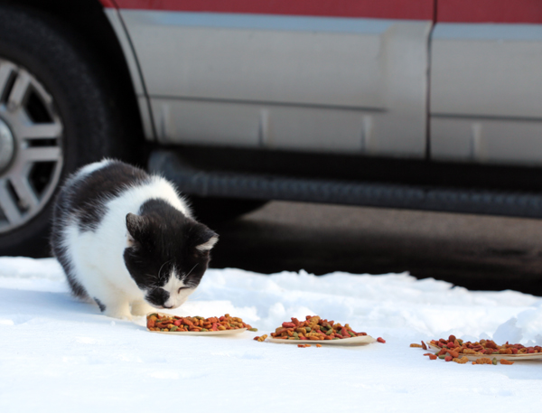
Feeding bans don’t work because:
Unenforceable and caretakers will feed anyway
Cats don’t pack up and move away – they remain, find new food sources if necessary & continue to reproduce
Goal of starving the cats to death is inhumane

Slide 16
Quick responses
“Ban anyone from feeding them and we won’t have a cat problem.”
“While you’re at it, can you ban rain on Sundays?”
“Name one town or city where a feeding ban succeeded in eliminating the cats.”
“You can’t outlaw compassion.”

Slide 17
Laws regulating cats don’t work because:
Licensing, running-at-large bans and pet limits are largely intended to regulate owned cats, not community cats
“Caretakers” do not consider themselves “owners”
Enforcement issues arise when colony caretakers either accidentally or intentionally are covered by laws
All effective enforcement can accomplish is deterring caretakers, not stopping unowned cats from existing or reproducing

Slide 18


Quick responses
“Let’s pass a law requiring all cats to be confined.”
“Who’s going to break the bad news to the homeless cats that they’re not allowed to roam free any more?”
“Who’s going to catch the offenders and who’s going to pay for enforcement?”

Slide 19
Step 3: Why TNR?
TNR lowers the number of cats because:
Spay/neutered cats can’t reproduce & attrition means fewer cats over time
A monitoring system (caretakers) can maintain progress
Many TNR groups remove adoptable cats at the outset
TNR helps protect against disease by:
Vaccinating against rabies (once is better than never!)
Spay/neutered and cared-for cats are healthier cats

Slide 20
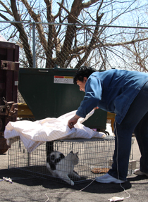
Step 3: Why TNR? (cont’d)
TNR reduces nuisance behavior because:
Noise from mating is eliminated
Odor from unneutered male cats spraying is eliminated
Sterilized cats roam less and become less visible
TNR reduces wildlife predation because:
Fewer cats means less predation

Slide 21
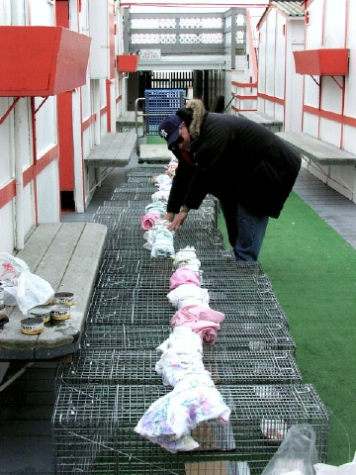
Other advantages to TNR
Caretaker cooperation & monitoring
Volunteer labor is plentiful because it’s life-affirming
New funding and other resources contributed by the public (individuals & nonprofits)
Aligned with public opinion
And besides, nothing else works!

Slide 22
Municipal level examples of TNR success
Newburyport, MA 1st community-wide TNR program in U.S. – 300 free-roaming cats along the riverfront in 1991, zero today
Albuquerque, NM (Targeting + RTF) – after 3 years of intensive community TNR, intake to the municipal shelter is down 39% and euthanasia down 85%
Sanders County, MT – after two years of TNR in its five towns, complaint calls to the only shelter in the county – Thompson River Animal Care Shelter - dropped 84% (from 1,032 in 2009 to 166 in 2011).

Slide 23
Academic examples of TNR success
Levy, J.K., Evaluation of the effect of a long-term trap-neuter-return and adoption program on a free-roaming cat population (2003) Journal of the American Veterinary Medical Association, Vol. 222, 42-46.

Slide 24
Stoskopf, M., Nutter, F., Analyzing approaches to feral cat management – one size does not fit all (2004) Journal of American Veterinary Medical Association, Vol. 225, 1361-1364.
Academic examples of TNR success (cont’d)
Studied colonies in rural county in North Carolina
6 colonies 100% sterilized
3 control colonies 100% unsterilized
All colonies:
  - Food and water daily
  - Adequate shelter
  - Vaccinated for rabies and common diseases
  - Treated annually for worms

Slide 25
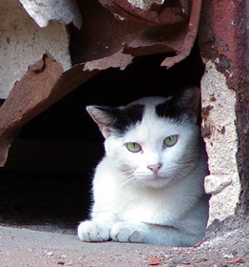
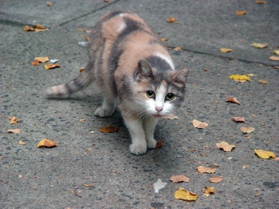
Stoskopf study - results
After two years:
- Sterilized colonies decreased average of 36% (range = 30% to 89%)
- Control colonies increased average of 47% (actual = 31%, 127% and 283%)

Slide 26
Impact of TNR on cat intake
Levy, J.K., Effect of high-impact targeted trap-neuter-return and adoption of community cats on cat intake to a shelter (2014) The Veterinary Journal, Vol. 201, pp. 269-274.
2,366 cats in one Alachua County zip code were spayed or neutered over two years (= 54% of estimated community cat population)
S/n rate per capita for cats 5 times higher in target area than rest of county
Intake to county shelter from target zip down 66% during study period
Intake down 12% in rest of county

Slide 27

More examples of success
Print version: www.amazon.com
search Amazon for: “Kortis”
Pdf file (free download): www.petsmartcharities.org/sites/default/files/CommunityTNR.zip
  search Google for: “PetSmart Charities Community TNR”
Detailed case studies at end of chapters 4, 5 & 6

Slide 28
Local examples of TNR success
Do some research – any groups in your area performing TNR (shelters, TNR , rescue, shelters, animal control)?
Will they share their data re: impact?
Government is conservative by nature, not wanting to be experimental or first to try something
Municipal officials relate best to local results
Any ideas?

Slide 29
Avoid your opponents’ trap!
After Step 1 (problems) has been presented, move quickly to Steps 2 (alternatives to TNR) and 3 (TNR)
3
2
1
The issue IS NOT whether free-roaming cats can have negative impacts.
The issue IS how can we lower their numbers and reduce whatever negative impacts there are.

Slide 30
More time in the red – you lose!
Cats kill birds!
Cats are not a native species
Cats spread rabies and other diseases
Shelters are overrun
People poison, shoot, mutilate cats
My backyard smells awful
Digging up the garden
Tons of complaints
How do we fix the problems?
Solutions
PROBLEMS

Slide 31
More time in the green – that’s how you win
Trap and euthanize doesn’t work because….
Feeding bans fail because….
Laws don’t work because….
TNR does work because….
A pilot project would look like….
Free-roaming cats can adversely impact wildlife, public health & shelters.
Problems
SOLUTIONS

Slide 32

The anti-TNR argument is really….
… an emotional appeal designed to create fear and prejudice against free-roaming cats and, by association, TNR.
99% of your opponents’ argument will be devoted to detailed descriptions of the problems, not proposing a solution
The goal is to persuade the decision maker that TNR is somehow the cause of the problems, despite this being illogical
Disturbing graphic images are often shown (cats with birds in their mouths, injured small animals, acts of cruelty)

Slide 33
Pivoting from problems to solutions
“The Wildlife Society says feral cats in the U.S. kill billions of birds and small mammals every year.”

Slide 34
Pivoting from problems to solutions
“The Wildlife Society says feral cats in the U.S. kill billions of birds and small mammals every year.”
“The issue isn’t how many wildlife are being killed, but how can we reduce that amount, whatever the real number is. Fewer free-roaming cats mean less predation. TNR is the only method known that realistically can accomplish this.”

Slide 35
Pivoting from problems to solutions
“Cats are the domestic animal most likely to expose people to rabies. Every time that happens, lives are at risk and the financial costs to our health department are enormous.”

Slide 36
Pivoting from problems to solutions
“Cats are the domestic animal most likely to expose people to rabies. Every time that happens, lives are at risk and the financial costs to our health department are enormous.”
“Not allowing TNR isn’t going to reduce the risk of rabies exposures from free-roaming cats. Vaccinating them and reducing their numbers as part of a TNR program will.”

Slide 37
Pivoting from problems to solutions
“Having cats living outdoors on their own is inhumane. Have you seen the photos of the stray cats involved in the cruelty case on Elm Street?

Slide 38
Pivoting from problems to solutions
“Having cats living outdoors on their own is inhumane. Have you seen the photos of the stray cats involved in the cruelty case on Elm Street?
“Everyone here is against cruelty, but right now the cats that may become victims are already out there. What we need to discuss is how can we have fewer of them and better manage their care. That’s what TNR is all about.”

Slide 39
Data: “What you’re doing now isn’t working”
Cat intake – constant or rising
Complaint calls – constant or rising
Costs to the municipality – how much per cat removed/euthanized multiplied by number of cats annually
  may include trapping (animal control time), care at the shelter (shelter staff time), food/litter during holding period, euthanasia procedure, disposal of body
  If animal control/sheltering is contracted out, may be a set cost per cat

Slide 40
Show TNR has broad, mainstream support
Position statements:
The Humane Society of the United States
www.humanesociety.org/issues/feral_cats/facts/TNR_statement.html
ASPCA
www.aspca.org/about-us/policy-positions/feral-cat-management.aspx
TNR-enabling legislation:
See www.neighborhoodcats.org/RESOURCES_ORDINANCES

Slide 41
$$$$$$
TNR can save tax dollars by:
Mobilizing volunteers to provide free labor (trapping, transport, etc.) for animal control
Attracting resources from nonprofits and private individuals to pay for surgeries and other aspects of the process
Lower intake/complaints
Funding is available to government agencies from PetSmart Charities:
Up to $100,000/yr. available for Free-roaming Cat Spay/Neuter grants (www.petsmartcharities.org/pro)

Slide 42
Who do you make the case to?
“Climb the ladder”
Level 1 - the agency or person most directly responsible for handling free-roaming cat issues (animal control, health department, police, sheriff). Speak to them first.
Level 2 – the office of the top executive of your jurisdiction (mayor, city manager, county executive). If you gain the support of level 1, bring them with you to level 2; if you don’t gain their support, bring counter-arguments
Level 3 – work your way up to the governing body (city or town council, county commission).
Look for and recruit any friendly faces along the way.

Slide 43
Pilot projects
Safe, noncommittal approach
Propose it if, after you’ve made your case, there is still hesitancy
Structure the pilot properly!!
  Involve your most reliable trappers and caretakers
  Don’t attempt a particularly difficult project, but one that will be relatively routine
  Keep good data (for preparing a report)
  Build in a direct, active role for government (e.g., transporting the cats, holding them overnight , using their veterinarian).

Slide 44
Have a plan for when you succeed
Present a proposal for a complete TNR program, including caretaker training, trap bank, spay/neuter, etc.
Identify the organization, agency or volunteers that will administer the program
Identify funding and other resources
Don’t persuade the municipality to try TNR and then not have anyone willing or able to do it!!

Slide 45
Don’t plead for the kitties!
Avoid emotional pleas on behalf of the cats – remember the job of government officials is about public welfare, not animal welfare
Present as a “cat population control expert” NOT a “cat lover”
Dress professionally (to the standard of your audience)
Leave the sweater with the paw prints at home!
YES
NO

Slide 46
Resources
Managing Community Cats: A Guide for Municipal Leaders
by The Humane Society of the United States
www.animalsheltering.org
“Trap-Neuter-Return: Fixing Feral Cat Overpopulation”
by The Humane Society of the United States (video, 16 min.)
www.youtube.com/watch?v=fTCTuJRkvng
“What is Trap-Neuter-Return?” (Neighborhood Cats TNR Handbook 2d ed, Chapter 2)
by Neighborhood Cats www.neighborhoodcats.org/RESOURCES_BOOKS_AND_VIDEOS

